Slide 1
Contract Choice in Agriculture and Other Applications
Shortcomings of Standard Neoclassical Economics
What determines the choice among contractual forms?
What are the effects of different contractual forms?
Are some contractual forms better than others?
The alleged inefficiency of share contracts

Slide 2
The Menu of Contracts between two agents
The Setting Two agents, One owning capital, the other owning labor
The problems of Adverse selection and Moral hazard
Fixed Wage Both Time and Piece Rate
Fixed Rent
Share contracts
What about slavery?

Slide 3
The Inefficiency of Share Contracts
Neoclassical model. It assumes transactions costs are zero, i.e. that contracts enforced without cost
Compared to both fixed wage and fixed rent contracts, share contracts would produce less output.
But then why should share contracts exist? Since they do exist, we have the “paradox of share contracts”
If there was sharing of input costs, then efficiency could be maintained

Slide 4
The Model
B
E
Rent
A
C
W/P
αMPN
MPN
D
O
N₂
N₁ = Labor

Slide 5
Implications
Employment of labor ON₁ in both wage and rent contracts
But it is only ON₂ in share contracts since the share tenant gets only a share α of his marginal product
Hence inefficiency of share contracts
But, given its existence, how can this be? The puzzle of sharecropping

Slide 6
Shortcomings of the Traditional Model
It focuses on only one form of moral hazard (labor-shirking ) whereas in reality there are many
These others are especially prominent in agriculture, fishing, tax collecting
Relevance of risk and risk bearing ability

Slide 7
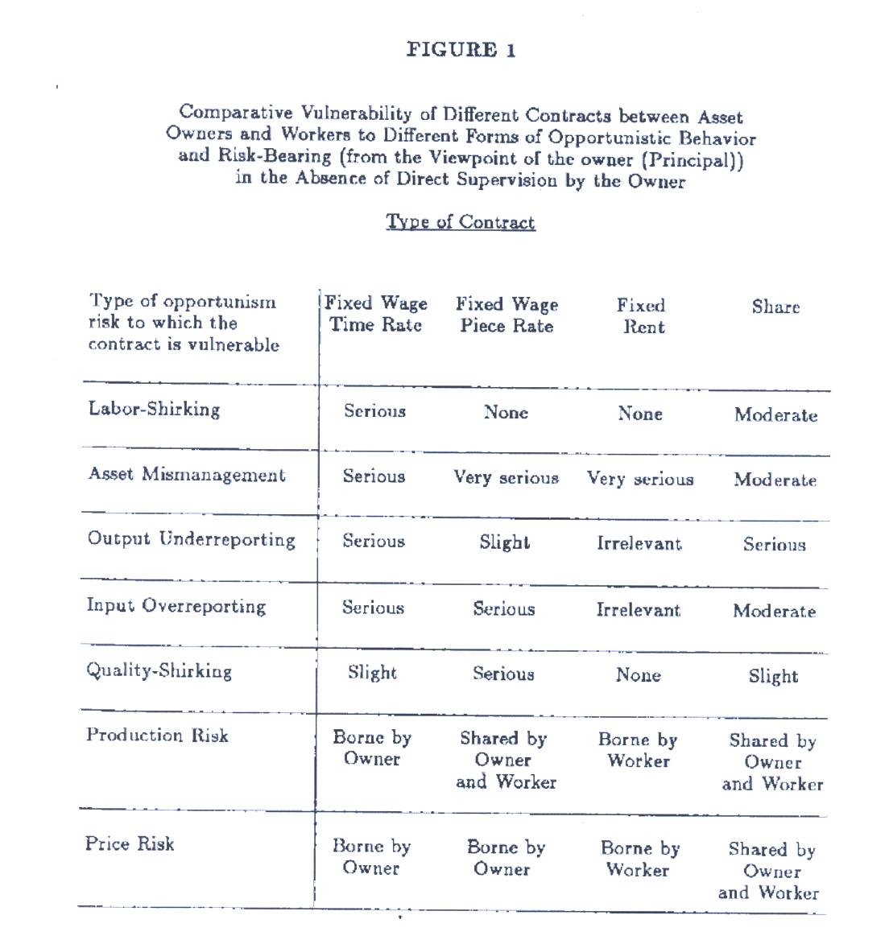

Slide 8
Some Variants to Explain existence of sharecropping
Cheung (1968,1969) Landowner not powerless. Could change size of land rented under share tenancy so as to give incentive of worker to work hard to meet subsistence needs.
Eswaran and Kotwal: Exchange non-marketed inputs
But these advantages might be dominated by the traditional disadvantages when numbers are large

Slide 9
Situations and Environments Dictate the Choice among contracts
When the various problems are most serious
Examples:
  Depletion of soil or abuse of agricultural equipment
  Quality may matter
  Labor shirking and difficulty of monitoring
  Under-reporting of inputs and output

Slide 10
Application to Pearling in Bahrain
What kind of contracts did they use?

Slide 11
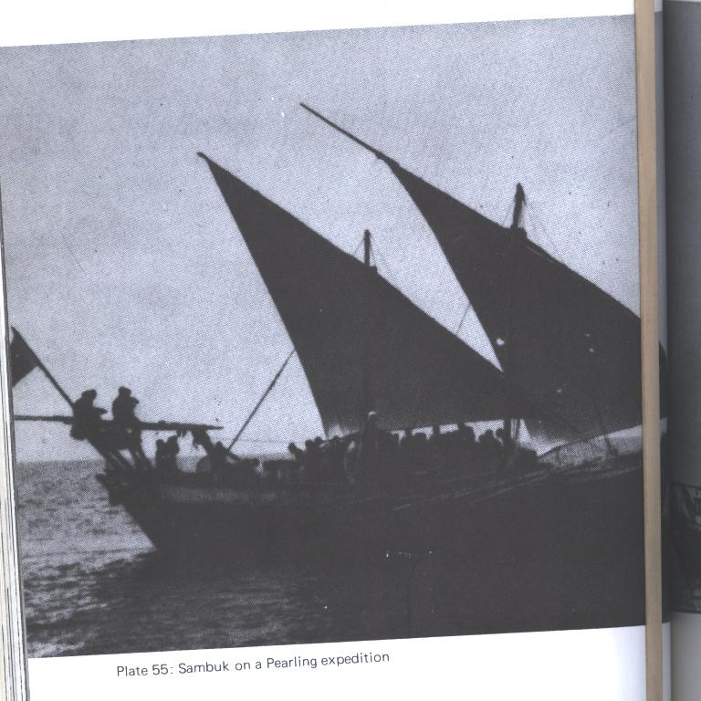
Section 3 takes up the first objective, which is to identify various reasons for believing that it may be important to consider the sectoral composition of output in examining the other effects of population aging mentioned above

Slide 12
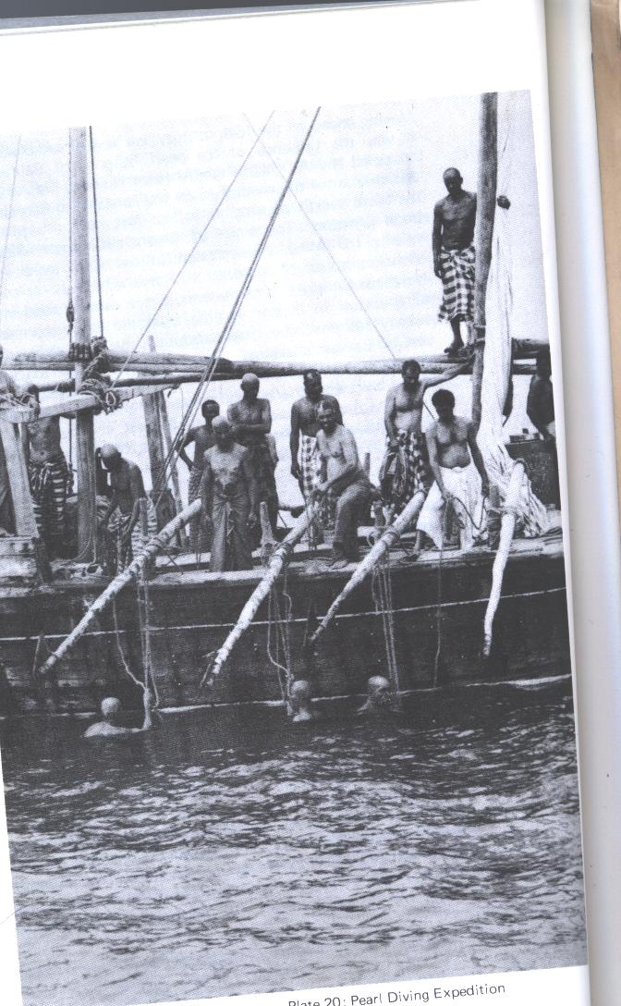

Slide 13
Pearling
Had been in existence for most of last 4000 years as dominant activity in the Gulf
It was a key, high-linkage industry with links to shipbuilding, trading and finance. Exports financed imports which were subject to tariff and hence revenue for local governments
Only minor competition from agriculture in the oases, some fishing
Its importance throughout the Gulf, especially Kuwait, Bahrain, Qatar, Iran, UAE,
Its demise in 1930s:

Slide 14
How It Worked
Seemingly, it changed little over the last 1000 years
Mixture of mining and fishing
Gulf conditions ideal: warm temperatures, not excessively saline or polluted. Could be done with primitive technology, little equipment except dhow, labor requirements could be satisfied nicely if people were experienced in the activity, relatively shallow depth of Gulf

Slide 15
Seasonality of the activity: June-September
Most other competing activities were also important at the same time.
Hence long slack season during which people had to be financed by credit
  Tiqsam beginning of slack season
  Silfa beginning of peak season to support families
  Kharjiya at beginning of pearling expedition

Slide 16
Large numbers of people involved
Owners, captains, divers, mechanics, pullers, cooks, singers, merchant –creditors
Virtually all paid by share contracts
Relation of pullers and divers, divers and captain, captains and owners very close
Each puller-rower had two divers in the water at same time
After about 10 dives each, these divers would come up to rest (drink coffee, eat lightly) while another relay would go in the water

Slide 17
Other characteristics
The simple technology: nose clips, ropes, oars
High production and price risk Quality of pearls unpredictable
  Difficulty finding them
  Risks of loss of ship and people to shipwreck, storms
  Weather risks
  Methods to reduce theft
Importance of Credit and Debts (Debt peonage)
The Reforms of the British in the 1920s and riots that followed. Debt bondage across generations. Why?

Slide 18
Responsibilities
Of captains (pilots)
Of pullers
Of owner-creditors
Recruitment patterns from within tribes
Owner hires captains, captains hire divers, divers hire pullers

Slide 19
Explanations
Extreme types
  Functionalism
  Exploitation
Interlinking of Credit and product market transactions lowers T - costs
Advantages of share contracts and the adjustments possible to avoid disadvantages, risk, reward to teamwork, exchange of non-tradable inputs
Short duration but with renewal possibilities
How creditor was compensated without interest
Flexible shares and exceptions to shares (mechanic)

Slide 20
Competitive Theory of Tenancy Choice
Alston, Datta and Nugent
JPE
Provide a model with transaction costs in form of labor shirking and supervision

Slide 21
The Model
Endowments of Labor and Land
  Nbar = N^{s}_{w} +T^{d}_{s}n_{s}
  Tbar = T_{w} +T^{d}_{s}
Production
y_{k} = f(n_{k}) where k = w,s

Slide 22
Shirking and Supervision of Labor
Π = prob. Of being detected shirking
λ = extent of shirking per unit of contracted labor under wage contract
C = supervision cost per unit of land
γ = penalty of being detected shirking
Π_{w} = Π_{w} (λ, c_{w}) , c_{w} = c_{w} (n_{w})
Π_{s} = Π_{s} (n_{s}, c_{s}) c_{s =} c_{s} (T^{i}_{s} )
γ_{w}= γ_{w} (λn_{w})
γ_{s}= γ_{s} (n_{s})

Slide 23
Assuming risk neutrality of both parties and using resource constraints
Max EI_{T} = (Nbar-T^{d}_{s}n_{s})[(1+λ)W
-Π_{w}(λ, c_{w}) γ_{w}(λn_{w})] + T^{d}_{s}{αf(n_{s})
-Π_{s} [n_{s}, c_{s} (T^{d}_{s} )] γ_{s} (n_{s})}
Max EI_{L} = (Tbar-T^{s}_{s})[f(n_{s}- λn_{w} )- Wn_{w} - c_{w}(n_{w})]
+ T^{s}_{s} (1- αf(n_{s}) – c_{s}(T^{s}_{s})]
Where α is tenant’s share of output under sharecropping, λW is wage earned moonlighting elsewhere
Equilibrium condition: T^{s}_{s from owner =}T^{d}_{s from tenant}

Slide 24
Implications
n_{w} <,=, > n_{s} all consistent with efficiency
Three special cases:
  w/o supervision, sharecropping inefficient (Bardhan and Srinivasan (1971)
  Supervision only on wage contracts as in Lucas (1979)
  Supervision only on share contracts
n_{s}

Slide 25
Empirical Application: Plantations in Georgia in 1911
US Census data had data on # supervisors, both owner and hired, also on contractual type
PF = f (S/A, PCA, POWS) Hyp (-, +, -)
PS = f (S/A PCA, POWS) Hyp (?,?,?)
S/A = (PF, PS, OS/A) (-,-, -)

Slide 26
Evidence
PF negatively affected by POWS, S/A
PS positively affected by PCA (labor intensive and risky)
S/A negatively affected by PF, PS, OS/A

